Slide 1

The Beauty of Poetry

Slide 2
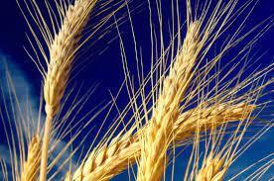

Slide 3
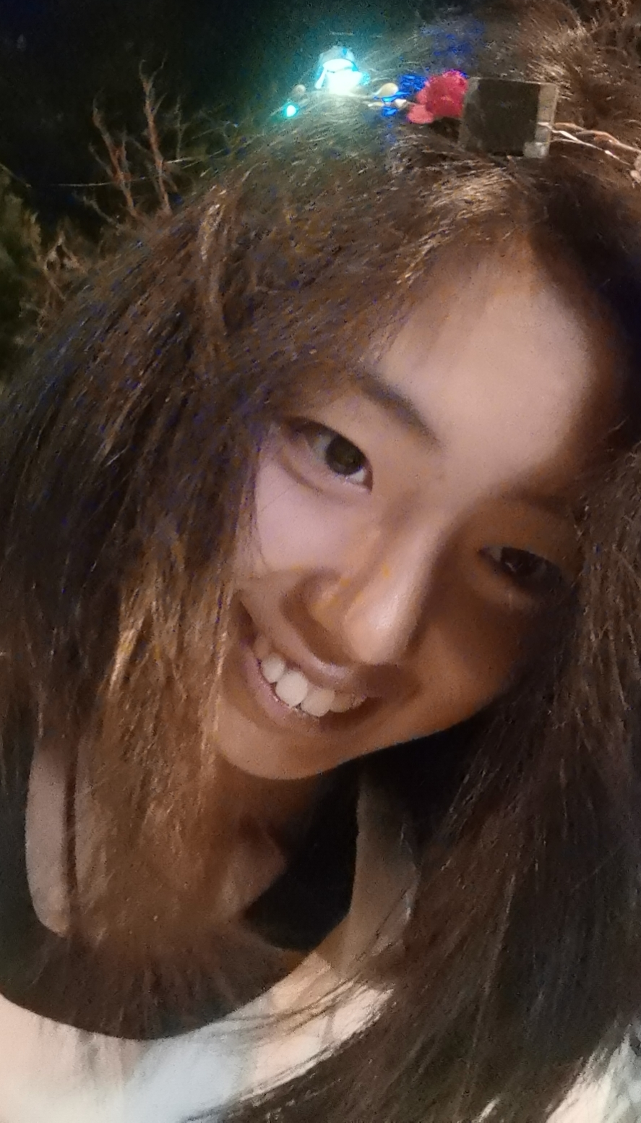
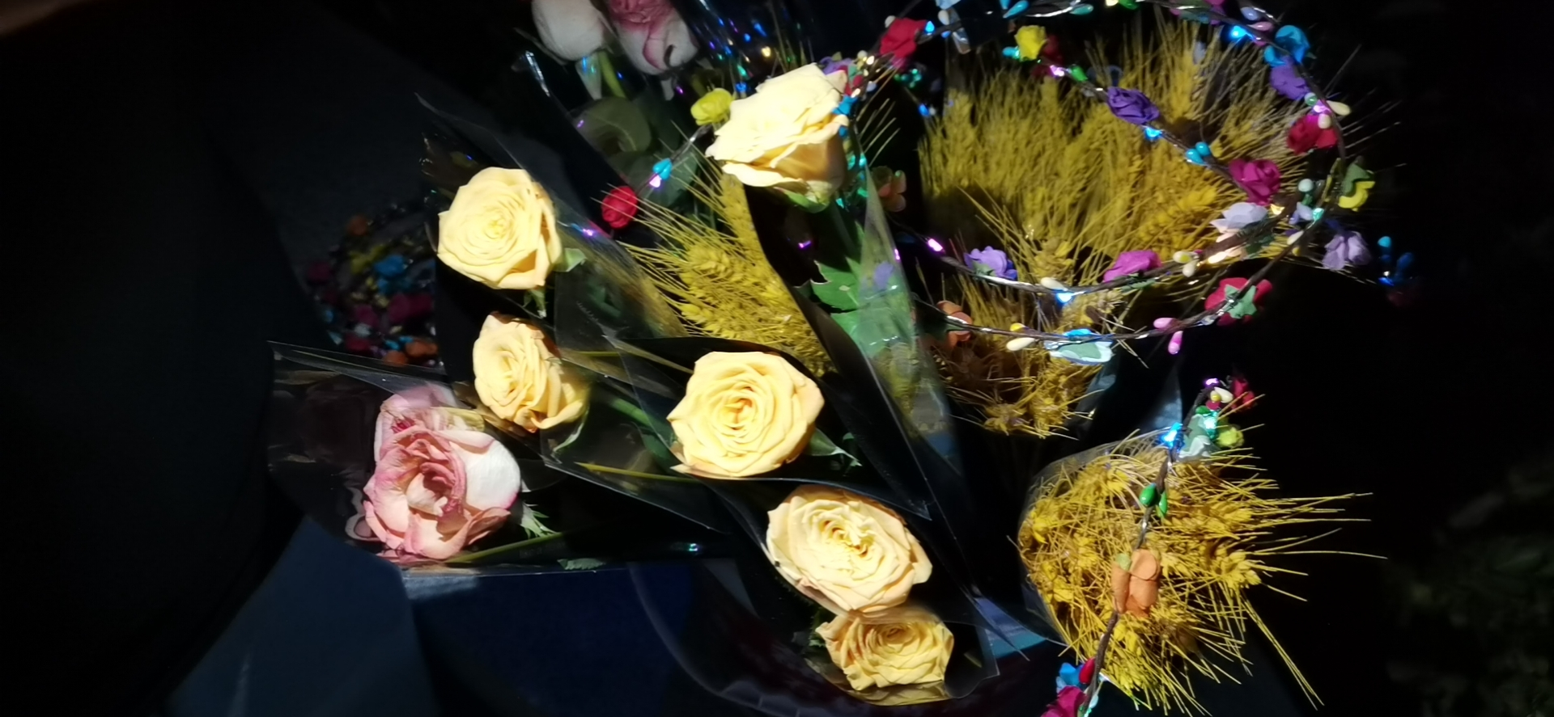

Slide 4
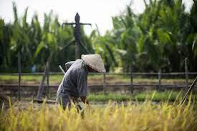

Slide 6
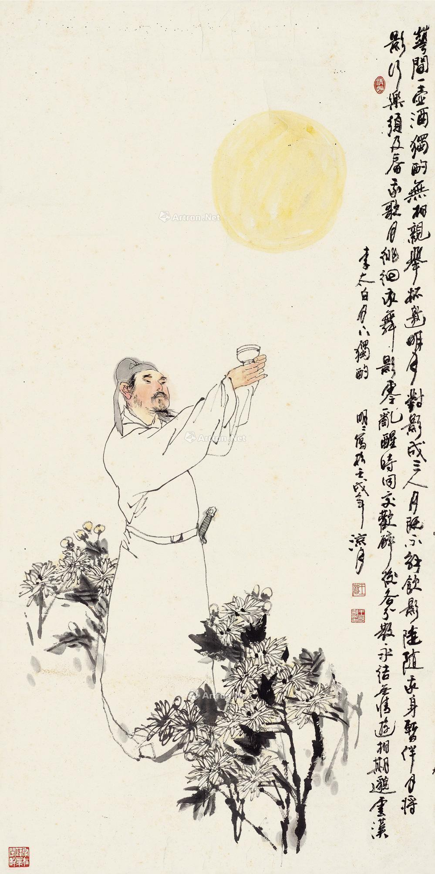
The Beauty of Philosophical Thinking
I raise my chalice to invite the shining moon,
the moon casts me a shadow and we have a triad.
--Drinking Alone Under the Moon

Slide 7
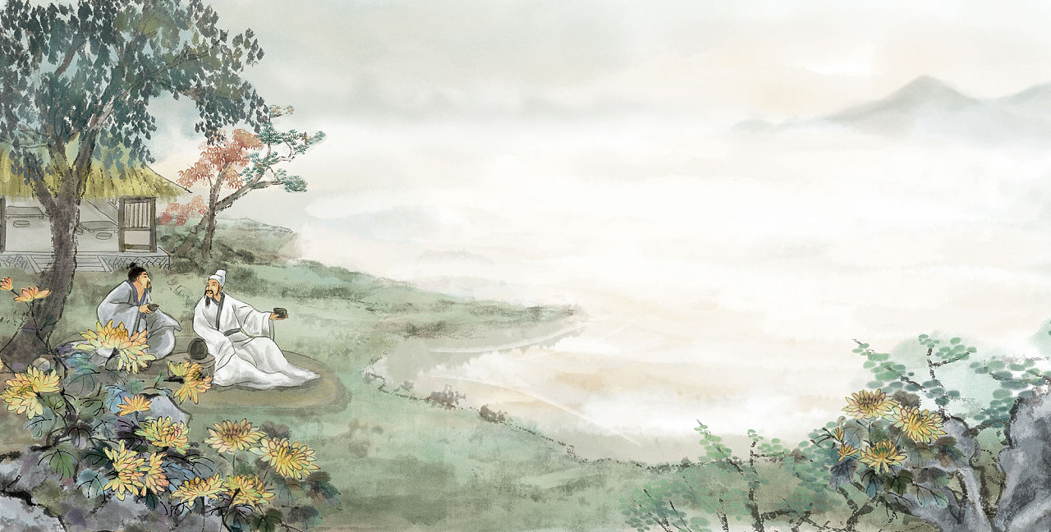
The Beauty of Nature
Alone the way there are clusters of lush green trees,
Once outside the town,
There stretch blue mountains on one side.
--Passing By An Old Friend's Farm

Slide 8
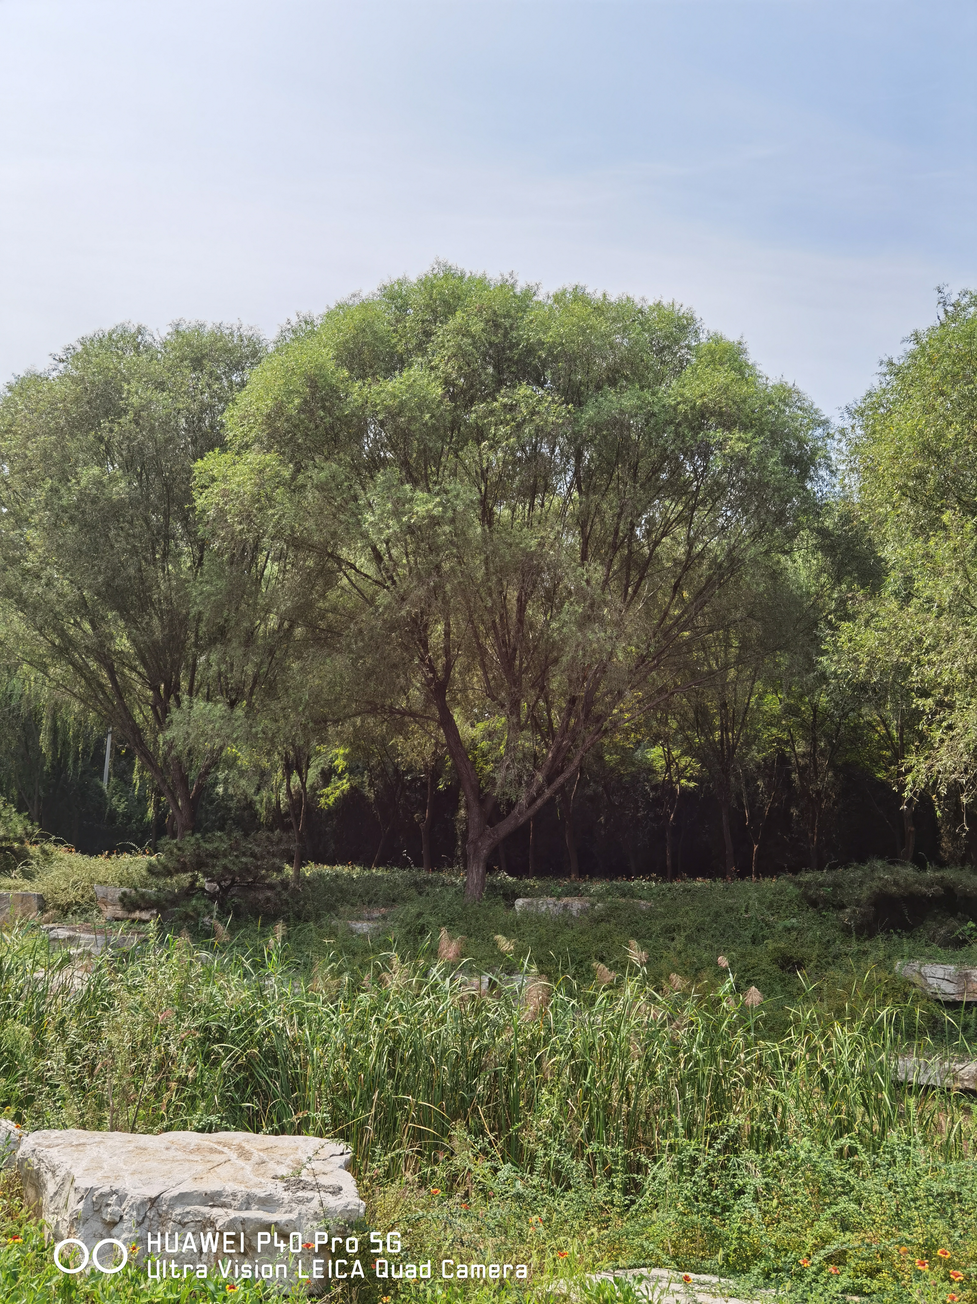
“All words of scenery is the words of emotion”

Slide 9
03
The inheritance of Poetry

Slide 10

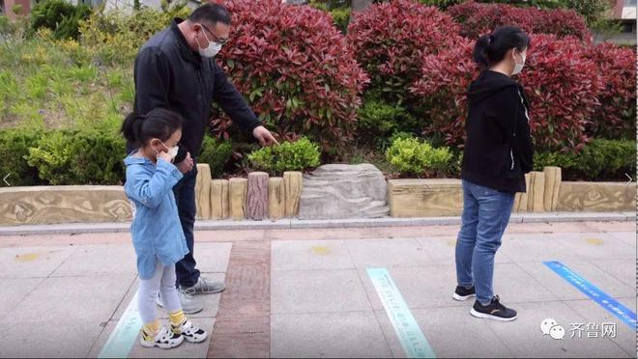
Ancient poems printed on one meter line

Slide 11

variety show：Everlasting Classics

Slide 12


Compulsory education textbook
The Chinese Poetry Competition

Slide 13
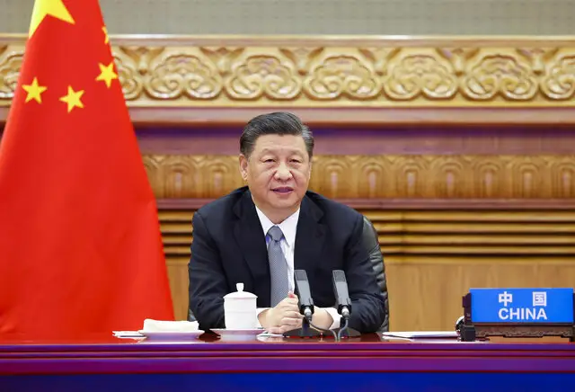
strengthen our cultural self-confidence
enhance our cultural soft power
maintain national cultural security
comprehensively promote socialist modernization

Slide 14
Thank You

